Slide 1
Laboratory Title: Data Analytics with Excel Laboratory Code: BCS358A

Slide 2
COURSE OUTCOMES:
At the end of the course, the student will be able to;
Use advanced functions and productivity tools to assist in developing worksheets.
Manipulate data lists using Outline and Pivot Tables
Use Consolidation to summarize and report results from multiple worksheets.
Apply Macros and Autofilter to solve the given real world scenario.

Slide 3
Expt No. | Title of the Experiments
1 | Getting Started with Excel: Creation of spread sheets, Insertion of rows and columns, Drag & Fill, use of Aggregate functions.
2 | Working with Data: Importing data, Data Entry & Manipulation, Sorting & Filtering.
3 | Working with Data: Data Validation, Pivot Tables & Pivot Charts.
4 | Data Analysis Process: Conditional Formatting, What-If Analysis, Data Tables, Charts & Graphs.
5 | Cleaning Data with Text Functions: use of UPPER and LOWER, TRIM function, Concatenate.
6 | Cleaning Data Containing Date and Time Values: use of DATEVALUE function, DATEADD and DATEDIF, TIMEVALUE functions.
7 | Conditional Formatting: formatting, parsing, and highlighting data in spreadsheets during data analysis.
8 | Working with Multiple Sheets: work with multiple sheets within a workbook is crucial for organizing and managing data, perform complex calculations and create comprehensive reports.

Slide 4
Expt No. | Title of the Experiments
9 | Create worksheet with following fields: Empno, Ename, Basic Pay(BP), Travelling Allowance(TA), Dearness Allowance(DA), House Rent Allowance(HRA), Income Tax(IT), Provident Fund(PF), Net Pay(NP). Use appropriate formulas to calculate the above scenario. Analyse the data using appropriate chart and report the data.
10 | Create worksheet on Inventory Management: Sheet should contain Product code, Product name, Product type, MRP, Cost after % of discount, Date of purchase. Use appropriate formulas to calculate the above scenario. Analyse the data using appropriate chart and report the data.
11 | Create worksheet on Sales analysis of Merchandise Store: data consisting of Order ID, Customer ID, Gender, age, date of order, month, online platform, Category of product, size, quantity, amount, shipping city and other details. Use of formula to segregate different categories and perform a comparative study using pivot tables and different sort of charts.
12 | Generation of report & presentation using Autofilter & macro.

Slide 5
Evaluation Sheet
For CBCS 2022 scheme:
Laboratory Components: 30 Marks (Observation Write up – 5 Marks + Lab Conduction – 10 Marks + Viva-Voce – 5 Marks + Record Writing – 10 Marks).
Laboratory IA tests: 20 Marks (IA test shall be conducted for 100 Marks (Write Up & Conduction -60 Marks, Viva-40 Marks) It is reduced to 20 Marks. Continuous Internal Evaluation (CIE) = 30 + 20 = 50 Marks. 3. SEE : 50* Marks (*The SEE will be conducted for 100 marks and proportionally reduced to 50 marks)

Slide 6
Experiment 1
Getting Started with Excel: Creation of spread sheets, Insertion of rows and columns, Drag & Fill, use of Aggregate functions.

Slide 7
Formulas
=AVERAGE(C3:H3)
=IF(AND(C4>35,D4>35,E4>35,F4>35,G4>35,H4>35), "Pass", "Fail")
=IF(AND(K4="Pass"),"Good!","Bad")
=MAX(C3:H3)
=MIN(C3:H3)
=AGGREGATE(1,6,C14:H14)
=SUM(C3:H3)

Slide 8
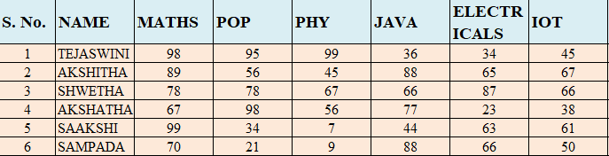
Given Data

Slide 9
Experiment 2
Working with Data: Importing data, Data Entry & Manipulation, Sorting & Filtering.

Slide 11
Data from web
Import spot prices for petroleum from website to excel
Import weather forecast for next 10 days
www.eia.gov/petroleum/
https://censusindia.gov.in/census.website/data/census-tables
https://www.indiacensus.net/states/karnataka

Slide 12
Experiment 3
TITLE: WORKING WITH DATA: DATA VALIDATION, PIVOT TABLES & PIVOT CHARTS.

Slide 13
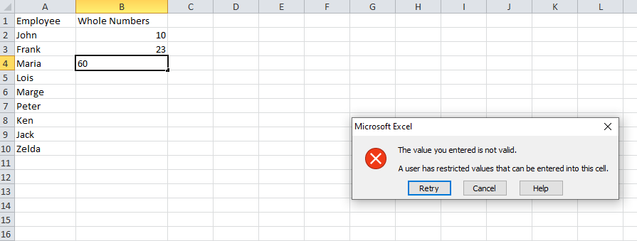
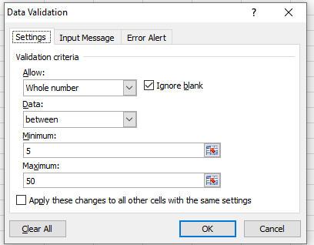
Data validation

Slide 14
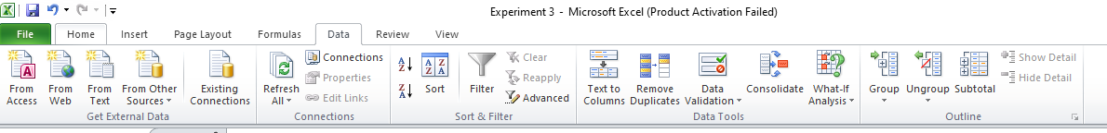
Data Validation to Cells
Use data validation to restrict the type of data or the values that users enter into a cell, like a dropdown list.
Select the cell(s) you want to create a rule for.
Select Data >Data Validation.

Slide 15
In the Settings tab, under Allow, select an option:
Whole Number - to restrict the cell to accept only whole numbers.
Decimal - to restrict the cell to accept only decimal numbers.
List - to pick data from the drop-down list.
Date - to restrict the cell to accept only date.
Time - to restrict the cell to accept only time.
Text Length - to restrict the length of the text
Custom – for custom formula.

Slide 16
=ISNUMBER(C2)
=ISTEXT(D2)
COUNTIF(cell,"text*")
AND(cell>=start_date), cell<=end_date)
=AND(C2>=$F$1, C2<=$F$2)

Slide 17
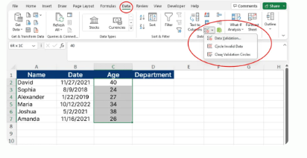

Slide 18
A Pivot Table
A pivot table is a summary of your data, packaged in a chart that lets you report on and explore trends based on your information.
Pivot tables are particularly useful if you have long rows or columns that hold values you need to track the sums of and easily compare to one another.

Slide 19
Pivot tables are powerful tools for summarizing and analyzing large amounts of data.
1. Creating a Pivot Table:
Select the range of cells that contain your data.
Go to the “Insert” tab and click on “PivotTable.”
Choose where to place the pivot table (new worksheet or existing worksheet).
2. Building Pivot Table:
Drag and drop fields into the Rows and Columns areas to arrange data.
Drag numeric fields into the Values area to perform calculations (e.g., sum, average).

Slide 20
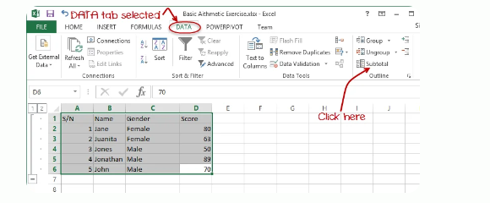
3. Filtering and Grouping:
Use the filter and grouping options within the pivot table to focus on specific data.

Slide 21
Pivot Charts:
Pivot charts are visual representations of data created from a pivot table.
1. Creating a Pivot Chart:
After creating a pivot table, select any cell in the pivot table.
Go to the “Insert” tab and click on “PivotChart.”
Choose the chart type you want.

Slide 22
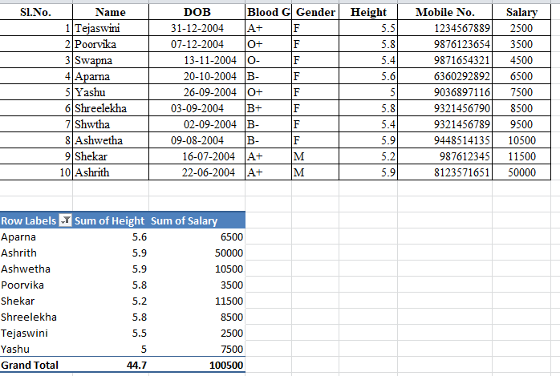

Slide 23
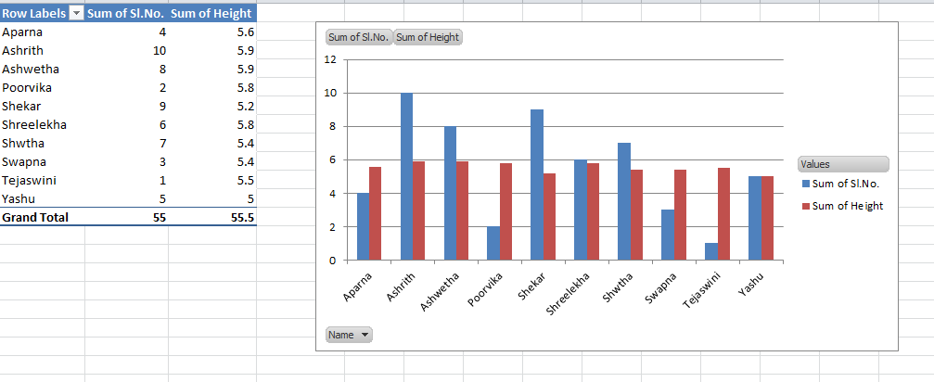

Slide 24
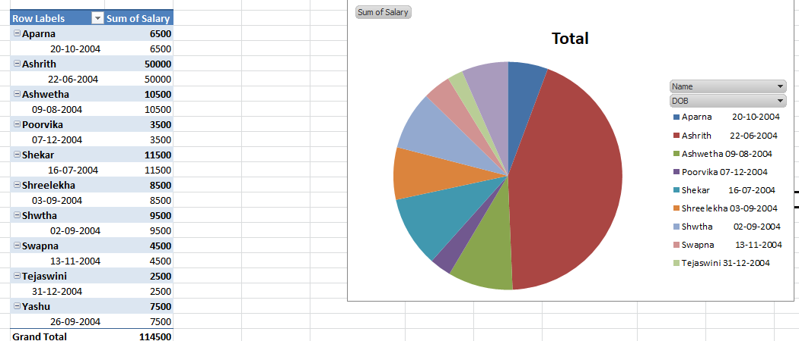

Slide 25
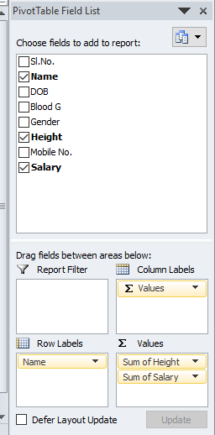
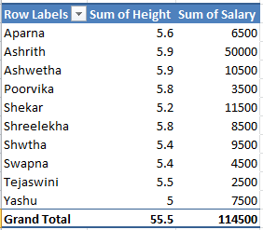

Slide 26
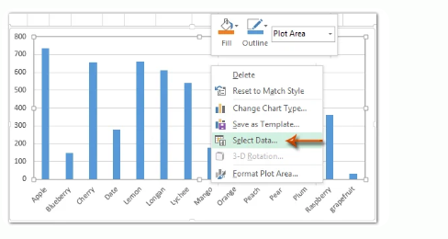
2. Customizing Pivot Charts:
Modify the chart layout, styles, and colors.
Use the “Filter” and “Slicer” options to interactively control the data displayed in the chart.

Slide 27
Experiment 4
Data Analysis Process: Conditional Formatting, What-If Analysis, Data Tables, Charts & Graphs.
LEARNING OBJECTIVES:
To learn the data analysis.
To work on conditional formatting.
To perform what if analysis, data tables, charts & graphs.

Slide 28
Conditional Formatting:
1. Highlighting Cells:
Use conditional formatting to highlight cells based on certain criteria (e.g., values greater than or less than a specific number).
The conditions are rules based on specified numerical values or matching text.
Changing the appearance of cells can visually highlight interesting data points for analysis.

Slide 29
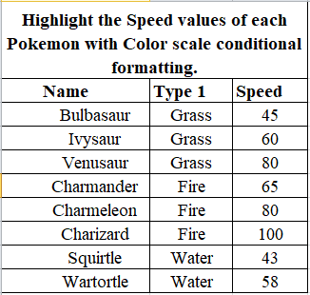

Slide 30
Click on the Conditional Formatting icon in the ribbon, from the Home menu
Select Color Scales from the drop-down menu
There are 12 Color Scale options with different color variations.
The color on the top of the icon will apply to the highest values.
Click on the "Green - Yellow - Red Colour Scale" icon

Slide 31
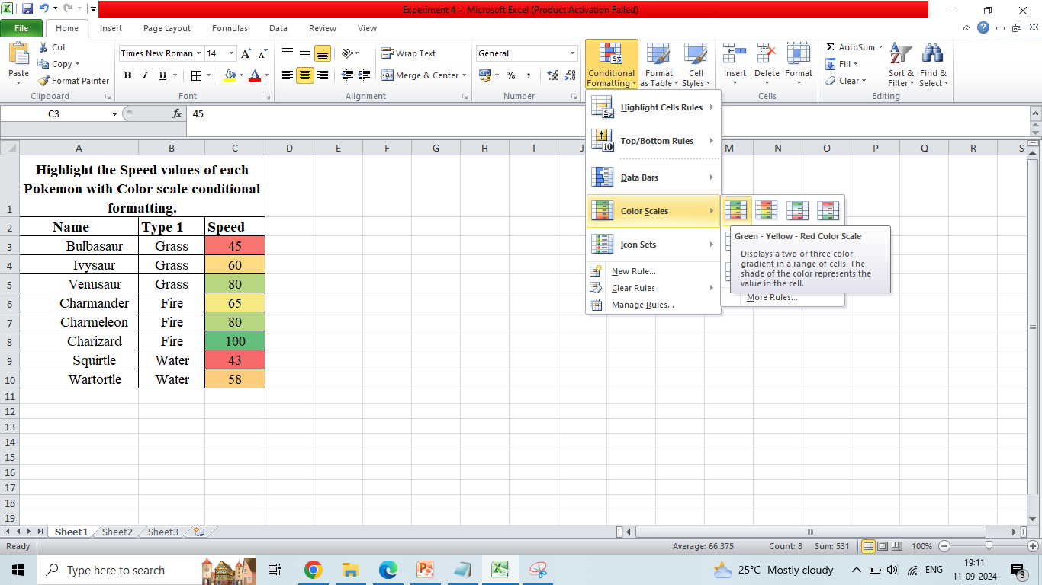

Slide 32
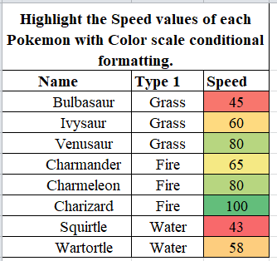

Slide 33
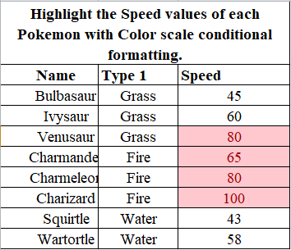
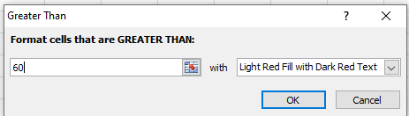

Slide 34
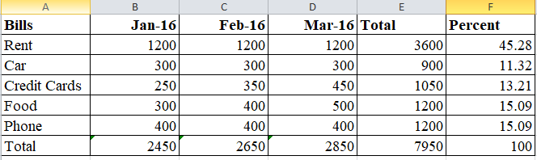

Slide 35
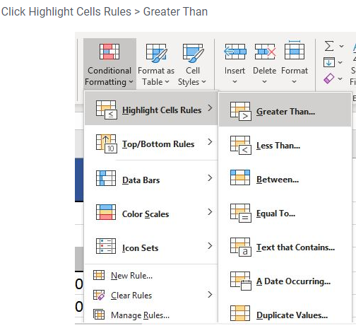

Slide 36
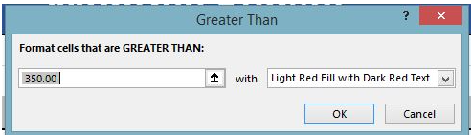
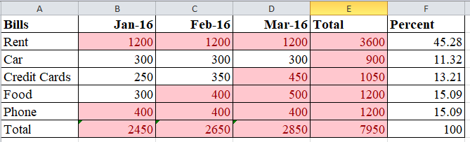

Slide 37
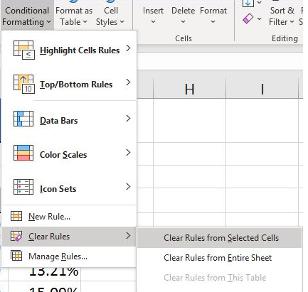

Slide 38
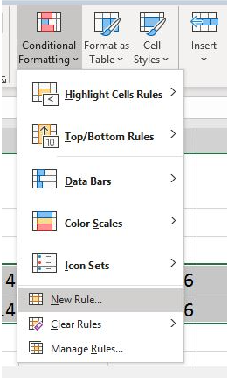

Slide 39
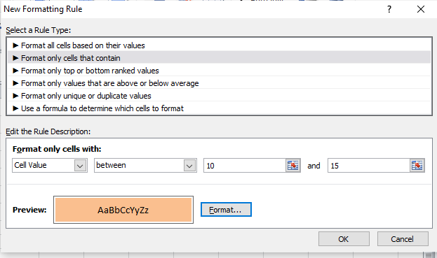
Select the column or row to which to apply
Example select last percentage column only values

Slide 40
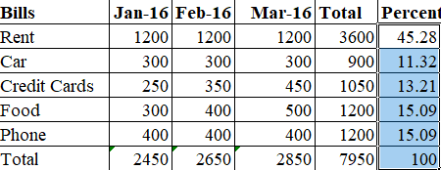
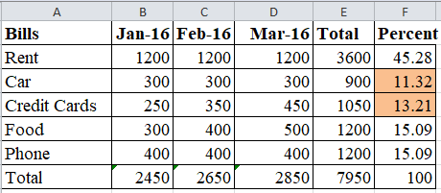

Slide 41
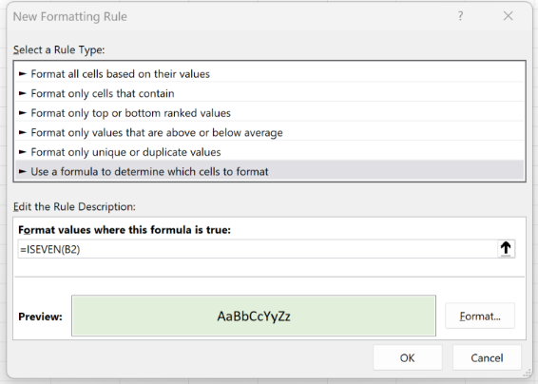

Slide 42
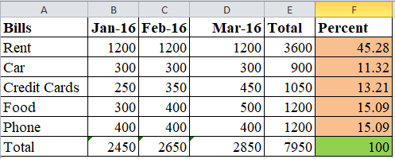
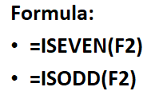
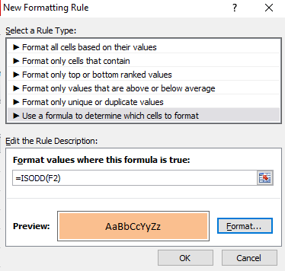
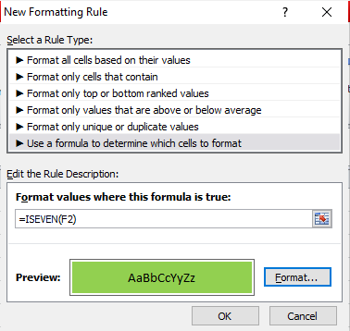
Highlight Percent only odd and even values.

Slide 43
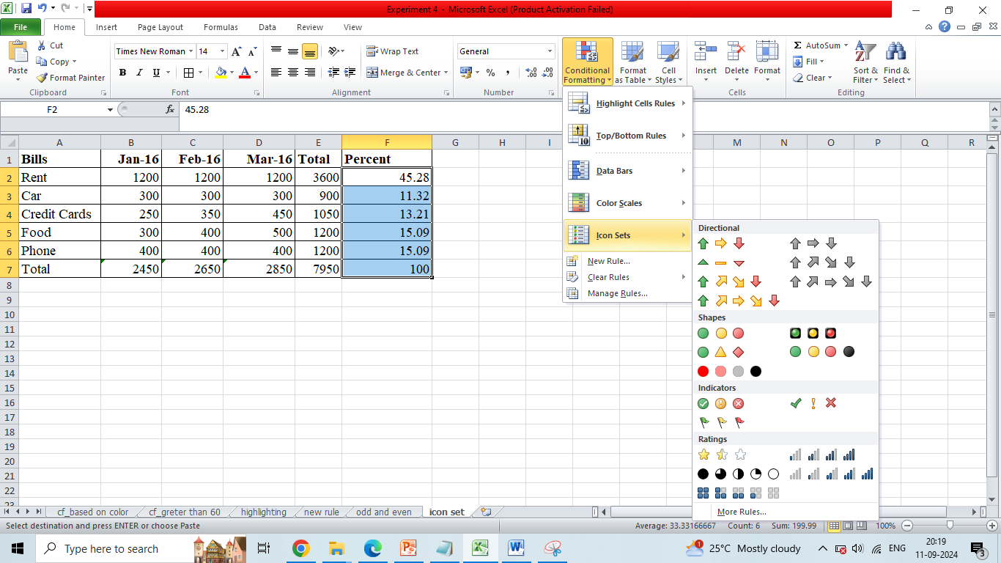

Slide 44
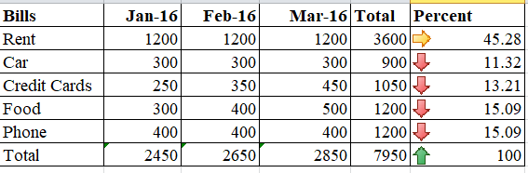

Slide 45
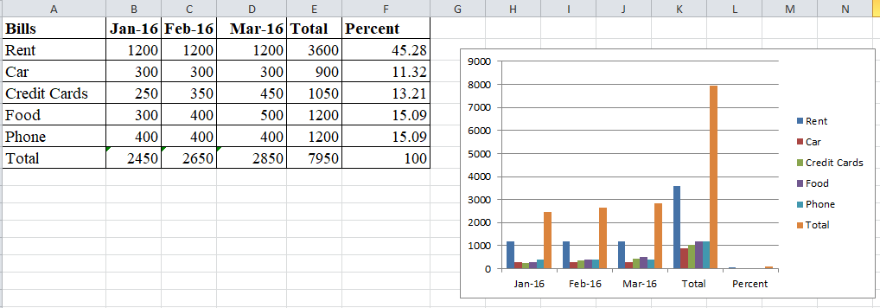
Chart and graphs

Slide 46
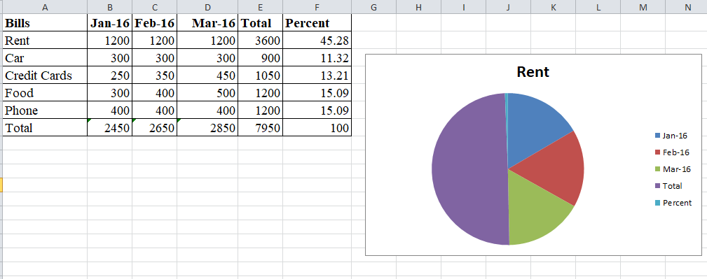

Slide 47
What if Analysis

Slide 48
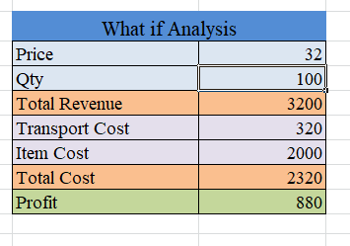

Slide 49
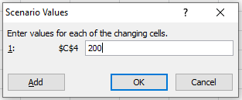
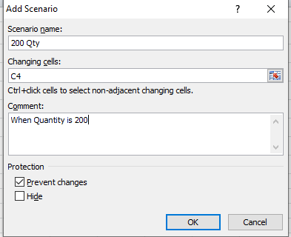
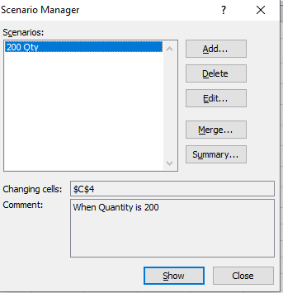

Slide 50
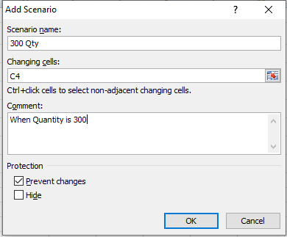
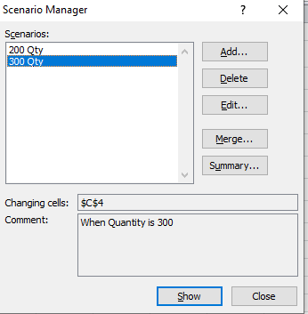

Slide 51
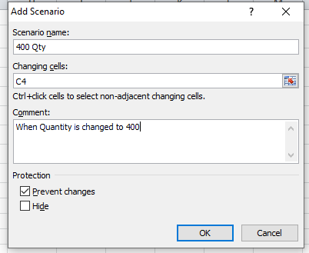
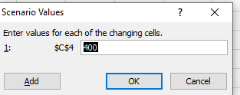

Slide 52
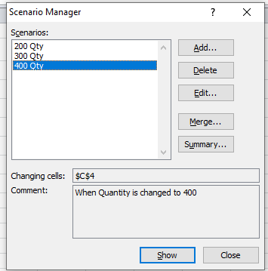

Slide 53
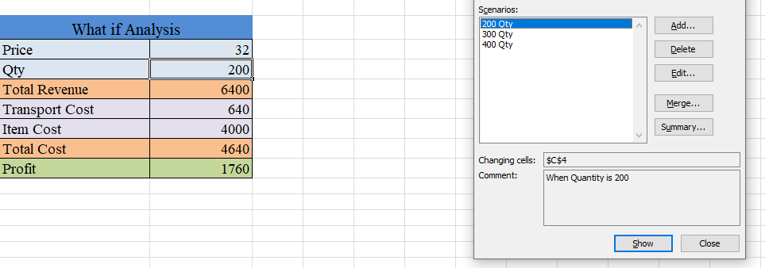

Slide 54
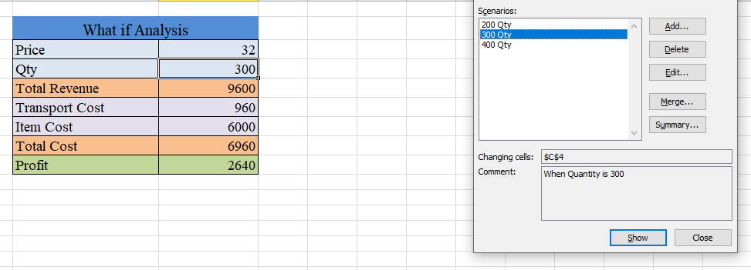

Slide 55
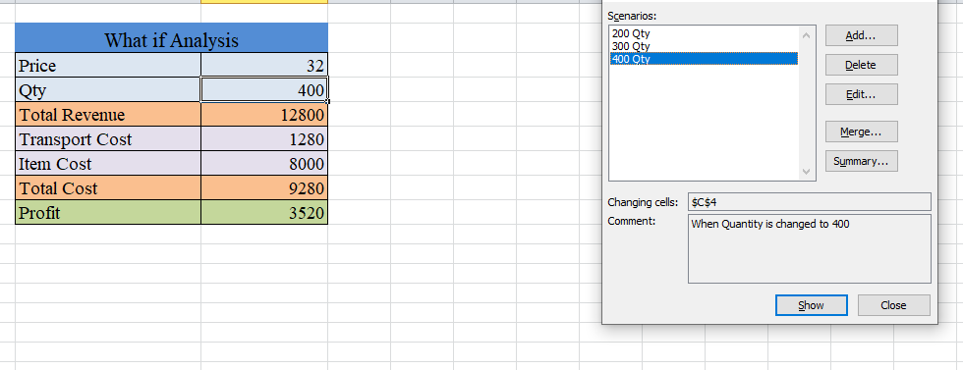

Slide 56
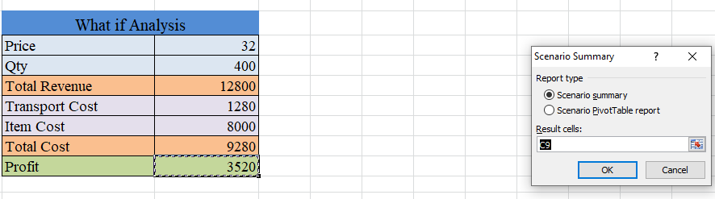
Click on summary

Slide 57
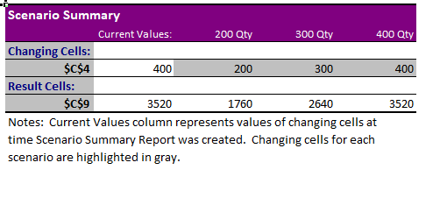

Slide 58
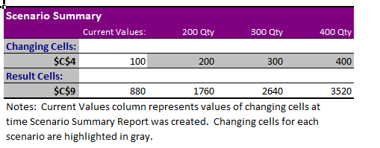
Change the input table Quantity to 100 then view the summary the table is updated.
The current value is added in scenario summary
Add the multiple scenarios and observe the result.

Slide 59


Slide 60

Goal Seek: What is the right value to be added to obtain the goal
Goal we know what should be right value for the quantity that we need to find using goal seek.

Slide 61


Slide 62

Remove the decimal value

Slide 63


Ex 2: Remove the quantity and update target
Similarly change the Price cell and
observe the difference

Slide 64

Data Table:

Slide 65


Slide 66


Slide 67
Experiment 5:
Cleaning Data with Text Functions: use of UPPER and LOWER, TRIM function, Concatenate.

Slide 68
UPPER and LOWER Functions:
UPPER Function:
Converts text to uppercase.
Syntax: =UPPER(text)
Example: =UPPER(A1) converts the text in cell A1 to uppercase.
LOWER Function:
Converts text to lowercase.
Syntax: =LOWER(text)
Example: =LOWER(B1) converts the text in cell B1 to lowercase.

Slide 69


Slide 70


Slide 71
TRIM Function:
1. TRIM Function:
Removes extra spaces from text, except for single spaces between words.
Syntax: =TRIM(text)
Example: =TRIM(C1) removes extra spaces from the text in cell C1.

Slide 73
To join multiple cell values with a comma, we can use a formula based on the SUBSTITUTE and TRIM functions.
Suppose we are given the following data:
The formula first joins the values in the four cells to the left using the concatenation operator (&) and a single space between each value.
The TRIM function is used to “normalize” all spacing. TRIM automatically strips space at the start and end of a given string and leaves just one space between all words inside the string.
It takes care of extra spaces caused by empty cells. SUBSTITUTE is used to replace each space (” “) with a comma and space (“, “).
We used a delimiter to join cells.

Slide 74


Slide 75

=SUBSTITUTE(TRIM(B5&" "&C5&" "&D5&" "&E5)," ",", ")
=SUBSTITUTE(TRIM(B6&" "&C6&" "&D6&" "&E6)," ",", ")
=SUBSTITUTE(TRIM(B7&" "&C7&" "&D7&" "&E7)," ",", ")

Slide 76
CONCATENATE Function:
Combines multiple text strings into one.
Syntax: =CONCATENATE(text1, [text2], ...)
Example: =CONCATENATE(A1, " ", B1) combines the text in cells A1 and B1 with a space in between.
=CONCATENATE("Revenue for"," ",B6," ","zone"," ","is"," ",C6,"mn")

Slide 77


Slide 78



Slide 79
Experiment 6:
Cleaning Data Containing Date and Time Values: use of DATEVALUE function, DATEADD and DATEDIF, TIMEVALUE functions.

Slide 80
DATEVALUE Function:
Purpose: Converts a date string to a serial number that represents the date.
Example ( Excel): =DATEVALUE("2024-01-05")
Usage: Convert text representations of dates into a format that can be used for calculations.

Slide 81


=DATEVALUE("01/01/2017")

Slide 82


Slide 83

In the format cells select the date format the format will be changed.

Slide 84

Example 2:
=DATEVALUE(B7)

Slide 85

=DATEVALUE(G10 & "/" & H10 & "/" & I10)
We get 43,071
Right click- Format cells-Select date- We get it in Date format

Slide 86
DATEADD Function:
Excel does not have a native `DATEADD` function, but you can use arithmetic operations to add days to a date.
For example, to add 5 days to the date in cell A1, you can use: `=A1 + 5` - To subtract days, you can use: `=A1 - 5`

Slide 87


=TODAY( ) Returns Current Date
=NOW( ) Returns Current date and Time

Slide 88

=DATE(YEAR(A2) + 5, MONTH(A2), DAY(A2))
=DATE(YEAR(A3), MONTH(A3)+2, DAY(A3))
=DATE(YEAR(A4), MONTH(A4), DAY(A4)+20)

Slide 89
The DATEDIF Function in Excel is categorized under Excel Date/Time functions.
As a financial analyst, we may require the number of days, months, or years between two dates.
The DATEDIF function helps us calculate the difference.
The DATEDIF function in Excel calculates the difference between two dates in days, months, or years.
Its syntax is =DATEDIF(start_date, end_date, unit) with units like “Y” for years, “M” for months, and “D” for days.

Slide 90



Slide 91

=DATEDIF(B4,C4, "d")
=DATEDIF("10/05/2015", "10/07/2017", "d")

Slide 92

Number of Weeks:
=(DATEDIF(C12,D12,"d")/7)
=(DATEDIF(C13,D13,"d")/7)
=(DATEDIF(C14,D14,"d")/7)

Slide 93

=DATEDIF(C6, D6, "m")
=DATEDIF(H6, I6, "ym")
=EDATE(B15,(DATEDIF(B15,C15,"y")+1)*12)

Slide 94

Suppose a flower store is required to send flowers to its customers on an anniversary date. We wish to calculate the next anniversary date. The data given are:
=EDATE(B15,(DATEDIF(B15,C15,"y")+1)*12)

Slide 95
4. TIMEVALUE Function:
The TIMEVALUE Function is categorized under Excel DATE/TIME functions.
TIMEVALUE helps us convert a text representation of a time to MS Excel time.
In MS Excel, time is stored internally as a numerical value. It doesn’t recognize time in text form.
Hence, the TIMEVALUE function allows us to convert the text representation of a time into a decimal that is recognizable as time.

Slide 96


Slide 97
=TIMEVALUE("8:30 PM")
=TIMEVALUE("8:30 AM")
=TIMEVALUE("18:30:00")
=TIMEVALUE("00:08:30 PM")
=TIMEVALUE("1/1/2017 8:30 PM")
=TIMEVALUE("8:30 PM") - TIMEVALUE("8:30 AM")

Slide 98

Suppose we imported data in the following format:
Now we wish to put date and time in separate columns.
For this, we can use the formulas
=DATEVALUE(LEFT(B5,10)) and =TIMEVALUE(MID(B5,12,8)).

Slide 99
To get the date, we extract the first 10 characters of the value with LEFT: so DATEVALUE(LEFT(B5,10)) will return the date as 03/01/17.
The result is a text string.
For Excel to interpret it as a date, we wrap LEFT in DATEVALUE, which converts the text into a proper Excel date value.
For the time, we extract 8 characters from the middle of the value with MID: MID(B5,12,8), which returns “12:28:48.”
The result is in text form, so we use TIMEVALUE to interpret and convert it into Excel time.

Slide 100



Slide 101



Slide 102
7.
Conditional Formatting: formatting, parsing, and highlighting data in spreadsheets during data analysis.

Slide 103
Use conditional formatting in Excel to automatically highlight cells based on their content.
Apply a rule or use a formula to determine which cells to format.
Highlight Cells Rules:
To highlight cells that are greater than a value, execute the following steps.
1. Select the range B2:B7.

Slide 104


Slide 105


Slide 106

2. To highlight cells that are above average, execute the following steps.
Select the range B2:B7.
Average 66.5 Excel calculates automatically and updates

Slide 107


Slide 108


Slide 109


Slide 110

=$C2=“Karnataka”

Slide 111


Slide 112




Slide 113
=IF(OR(A1>1500,A1<700),TRUE,FALSE)
=OR($E5<2000,$E5>5000)
=AND($C5="Richard",$E5>5000)
=OR($D5= “North”,$E5>5000)

Slide 114
Data Parsing
In today’s data-driven world, the ability to extract, analyze, and organize information is crucial.
Excel, with its powerful features and versatile functions, has become the go-to tool for data manipulation.
However, parsing through large datasets can be a daunting task, especially for beginners.
That’s why this guide is here to help you navigate the complex world of data parsing in Excel, providing you with step-by-step instructions, practical tips, and useful techniques to effectively parse and transform your data.

Slide 115
Parsing data refers to the process of analyzing and transforming data from one format to another, making it more readable, structured, and usable for further analysis or processing.
It involves breaking down a string of data into its individual components and organizing them in a way that can be easily understood by humans or machines.

Slide 116

In Excel, you often have data exported from some other software.
It might be formatted as a long string delimited by a separator (comma, semicolon, etc.).
For example, see the picture below, which shows a list of products separated by semicolons in one cell (A1):

Slide 117

To view this data appropriately in Excel, use Text to Columns and split the products into separate columns.
Select the text cell (B1) and in the Ribbon, go to Data > Text to Columns.

Slide 118


Slide 119


Slide 120


Slide 121


Slide 122
Parsing Example 2:
"In 2023, Company A reported total revenue of $12.5 million, a 15% increase from 2022 when the revenue was $10.87 million. The company's expenses in 2023 were $7.8 million, up from $6.5 million in 2022. Meanwhile, Company B saw a revenue growth of 20%, reaching $9.6 million in 2023 compared to $8 million in 2022, with expenses rising from $5.3 million to $6.1 million."

Slide 123



Slide 124


Slide 125


Slide 126


Slide 127


Slide 128


Slide 129
Exp. 8
Working with Multiple Sheets: work with multiple sheets within a workbook is crucial for organizing and managing data, perform complex calculations and create comprehensive reports.

Slide 130
To Work with Multiple Sheets within a workbook is crucial for organizing and managing data, perform complex calculations and create comprehensive reports.

Slide 131
The First Step:
The first step is to set up a product catalog. Follow the steps given below −
Start with a blank workbook.
Set up product catalog worksheet with products and prices.
Name the worksheet Product Catalog.
Assume the catalog is revised on the first of every month.
Provide a place holder for last updated on.
The price of a product at selling time is determined by the current cost of the product.

Slide 132


Slide 133
Multiple Worksheets with same Structure
Next, you have to set up worksheets for the Regions – East, North, South, and West, in that order with same structure.
Add 4 blank worksheets.
Name the worksheets East, North, South and West.

Slide 134


Slide 135

These four worksheets should have the same structure.
Click the tab East. The East worksheet opens.
Press the shift key and click on the tab West. All the 4 tabs will be selected.

Slide 136
In the East worksheet,
Add the column headers – S. No., Month, Product, Price, No. of Units, Total Amount.
Add the S. No., Month April and the 4 Product Names.
Format the Table.
The same structure appears in the other worksheets North, South and West.

Slide 137


Slide 138
Creating a Formula across Multiple Worksheets
To create a formula across multiple worksheets
Define names for the price values of the products in the product catalog worksheet.
Set the Scope as Workbook for all the names.

Slide 139


Slide 140


Slide 141


Slide 142


Slide 143

Once again select all the four worksheets – East, North, South and West.
In the East worksheet, for each product, in the price column, give the formula as the Price Value Name.

Slide 144

Repeat the same steps for each Month

Slide 145

Data gets reflected in North, South, West sheets

Slide 146
Therefore, for the worksheets for the regions East, North, South, and West, you have successfully set the same structure and placed the price information for each product based on the month from product catalog worksheet.
The Product Catalog can be in another Workbook too.

Slide 147
Calculations in the Worksheets
The next step is to fill in the information of No. of Units sold for each Product in each Month and in each Region. Therefore, you need to work separately on these worksheets.
For each region, for each product −
Fill No. of Units sold.
Calculate the corresponding Total Amount as Price*No. of Units.

Slide 148


Slide 149
In each worksheet (East, North, South and West), calculate subtotals month-wise −
Note − You can use Subtotal on a single worksheet but not on multiple worksheets. Hence, you have to repeat this step for North, South and West worksheets.

Slide 150


Slide 151


Slide 152

Click the Outline Level 2. You will get all month-wise Totals.

Slide 153
Summarizing Data in Multiple Worksheets:
The following steps will show you how to summarize data from multiple worksheets.
Add a worksheet and name it Summary.
Create the structure for Summary worksheet.

Slide 154


Slide 155
Select the worksheet East.
Select the cell G7.
With East tab pressed, click the tab West.
The tabs East to West get selected.
The formula in the formula bar appears as
=sum(‘East:West’!G7)
The calculated value appears in the cell C3.
Copy the formula to the cells C4 to C7.
Click Show Formulas in the Formula Auditing group under the FORMULAS tab.

Slide 156


Slide 157


Slide 158
This is exactly how we wanted to summarize the results from each region.
Click in the cell C8 (Total named cell).
Type =sum(C3:C7)

Slide 159


Slide 160

Summarized results are ready in the Summary worksheet.

Slide 161


Slide 162
Exp 9.
Create worksheet with following fields: Empno, Ename, Basic Pay(BP), Travelling Allowance(TA), Dearness Allowance(DA), House Rent Allowance (HRA), Income Tax(IT), Provident Fund(PF), Net Pay(NP). Use appropriate formulas to calculate the above scenario.
Analyse the data using appropriate chart and report the data.

Slide 163
LEARNING OBJECTIVES:
To create a worksheet with following fields:
Empno, Ename, Basic Pay (BP), Travelling Allowance(TA), Dearness Allowance(DA), House Rent Allowance (HRA), Income Tax (IT), Provident Fund (PF), Net Pay (NP).
Use appropriate formulas to calculate the above scenario.
Analyse the data using appropriate chart and report the data.

Slide 164
TA= Basic Pay>=20,000, Basic Pay*20%, Basic Pay>=15,000, Basic Pay*15%, Basic Pay*10%
Or Travelling Allowance (TA): 10% of Basic Pay (BP)
Dearness Allowance (DA): 60% of Basic Pay (BP)
House Rent Allowance (HRA): 20% of Basic Pay (BP)
Income Tax (IT): 10% of Gross Pay (GP), where GP is the total before deductions
(Gross Pay (GP) can be calculated as BP + TA + DA + HRA)
Provident Fund (PF): 12% of Basic Pay (BP)
Net Pay (NP)= BP+TA+DA+HRA-(IT+PF)

Slide 165
TA: =IF(C2>=20000,C2*20%,IF(C2>=15000,C2*15%, C2*10%))
Gross Pay= BP + TA + DA + HRA

Slide 166
Travelling Allowance (TA): TA is an allowance given to employees to cover expenses related to work-related travel.
Dearness Allowance (DA): DA is a cost-of-living adjustment allowance paid to employees to counteract inflation.
House Rent Allowance (HRA):
HRA is provided to employees to help them with housing costs.
Income Tax (IT):
IT is a mandatory deduction applied to an employee's income as per government tax laws.
Provident Fund (PF): PF is a retirement savings scheme in which both employees and employers contribute a percentage of the employee's Basic Pay each month.
Basic Pay (BP): is the fixed portion of an employee's salary and serves as the foundation for calculating other salary components like allowances and deductions. It is a guaranteed part of the salary.

Slide 167


Slide 168


Slide 169


Slide 170
Exp. 10
CREATE WORKSHEET ON INVENTORY MANAGEMENT: SHEET SHOULD CONTAIN PRODUCT CODE, PRODUCT NAME, PRODUCT TYPE, MRP, COST AFTER % OF DISCOUNT, DATE OF PURCHASE. USE APPROPRIATE FORMULAS TO CALCULATE THE ABOVE SCENARIO.
ANALYSE THE DATA USING APPROPRIATE CHART AND REPORT THE DATA.

Slide 171
Total Stock:
Definition: The initial or maximum quantity of a product available at the start of a given period. It represents the baseline or starting inventory for that product.
Example: If you initially received 100 laptops, then 100 is the Total Stock for laptops.
OutStock (or Sold/Removed Stock):
Definition: The quantity that has been sold or removed from inventory.
This is the amount of stock that is no longer available because it was either sold or used up.
Example: If 20 laptops out of the original 100 were sold, then OutStock = 20.

Slide 172
Balance Stock (or Current Stock / InStock):
Definition: The current quantity available in inventory after accounting for what has been sold or removed. It represents the remaining stock that is still available for sale or use.
Calculation: You can calculate Balance Stock as: Balance Stock=Total Stock−OutStock
Example: If Total Stock was 100 laptops and OutStock is 20 laptops, then:
Balance Stock=100−20=80 laptops

Slide 173
Warranty (6 Months Added to Date of Purchase)
To calculate a warranty period of 6 months from the Date of Purchase, add 180 days to the date.
=EDATE(I2, 6)
This formula uses EDATE to add 6 months directly to the Date of Purchase.

Slide 174
The Status of Stock can be calculated based on the Balance Stock (or InStock) to indicate whether the item is readily available, running low, or out of stock.
Example Stock Status Categories
In Stock: If Balance Stock (or InStock) is greater than a certain threshold (e.g., 5 units), the item is considered in stock.
Low Stock: If Balance Stock is low (e.g., between 1 and 5 units), it’s labeled as "Low Stock" to indicate the need for restocking soon.
Out of Stock: If Balance Stock is 0, the item is out of stock.
=(IF(F2=0,"Out of Stock",IF(F2<=5,"Low Stock","In Stock")))
Balance Stock is in column F (starting at cell F2)

Slide 175


Slide 176
='inventory management'!A1
Assign the status value:
"In Stock" = 2
"Low Stock" = 1
"Out of Stock" = 0
=IF(D2="In Stock", 2, IF(D2="Out of Stock", 0, IF(D2="Low Stock", 1)))

Slide 177


Slide 178


Slide 179


Slide 180


Slide 181


Slide 182


Slide 183
Exp. 11
Create worksheet on Sales analysis of Merchandise Store: data consisting of Order ID, Customer ID, Gender, age, date of order, month, online platform, Category of product, size, quantity, amount, shipping city and other details. Use of formula to segregate different categories and perform a comparative study using pivot tables and different sort of charts.

Slide 184
The Sales Analysis of a Merchandise Store is a practical approach to understanding customer buying patterns, product performance, and financial metrics, using organized data and analytical techniques.
This analysis helps businesses optimize their sales strategies and improve decision-making.
Customer Information: Gender, Age, and Customer ID for demographic analysis.
Order Details: Date of Order, Online Platform, and Product Category to track sales trends and preferences.
Financial Metrics: Quantity, Rate (price per unit), Total Amount, Cost Price, and Profit to evaluate revenue and profitability.
Shipping Details: City and region for geographical analysis.

Slide 185
Total Cost: Definition: The total expense incurred to produce or purchase the products sold.
Total Cost=Cost Price (per Unit)×Quantity Sold
Cost Price: Assume 70% of the "Rate.“
Total Cost: Cost Price × Quantity
Profit: Total Amount−Total Cost
Total Amount: Definition: The total revenue earned from selling a product.
Total Amount=Rate (Price per unit) × Quantity
Profit Percentage (on Cost Price)=
(Profit/Total Cost​)×100
Profit Percentage (on Total Amount)=
(Profit/Total Amount​)×100

Slide 186


Slide 187


Slide 188


Slide 189
Exp. 12
Generation of Report & presentation using Autofilter & macro.

Slide 190

Step 1: Create a Sample Data Set:

Slide 191
Step 2: Apply AutoFilter
Now, let’s filter the data for better analysis.
Select the Data Range: Select all the data (including headers from columns A to L).
Enable AutoFilter:
Go to the Data tab on the Excel ribbon.
Click on the Filter button in the "Sort & Filter" group. You will now see drop-down arrows next to each column header.
Apply Filters:
Click the drop-down arrow in any column (e.g., Category of Product), and you can filter the data to show only specific products, for example, only "Jeans".
You can apply multiple filters like filtering by Shipping City, Gender, or Date of Order.

Slide 192
Step 3: Create a Pivot Table
Select Data Range: Select the range with your data.Insert Pivot Table:Go to the Insert tab and click on PivotTable.
Choose to place the Pivot Table in a New Worksheet.
Set Up the Pivot Table:
Step 4: Record a Macro to Automate the Process
Step 5: Running the Macro

Slide 193


Slide 194

Step 4: Record a Macro to Automate the Process

Slide 195


Slide 196


Slide 197


Slide 198


Slide 199

Record this onto Macro till Conditional Formatting

Slide 200

Enter any data onto Excel then Run the
Macros We can see it gets formatted

Slide 201


